Slide 1
Pin Map and Channel Map Generator User Manual

Slide 2
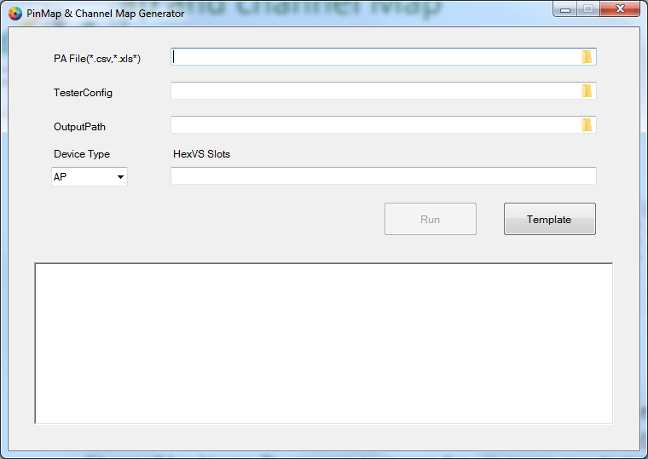
Pin Map and channel Map
Purpose : To generate pin map and channel map by PA file.
GUI
step2
step3
step4
step1

Slide 3
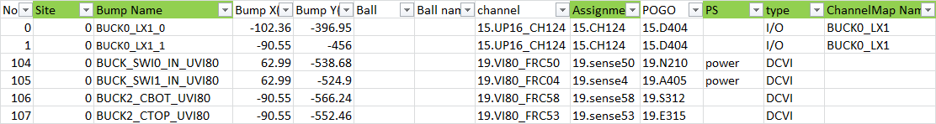
Pin Map and channel Map
Format for PA
Site : To define site for multi site test.
Bump Name : This is pin name in pin map and channel map.
Assignment : To define the channel of pin in channel map.
PS : User can specify this pin is power pin by using syntax “power”.
Type : To define the type of pin in channel map. (ex. I/O,DCVI,GND,Utility)
ChannelMap Name: To rename or merge the pin name. (ex. BUCK0_LX1_0 & BUCK0_LX1_1 use the same channel and merge into BUCK0_LX1) If channelMap Name is empty, tool will use Bump Name as pin name.

Slide 4
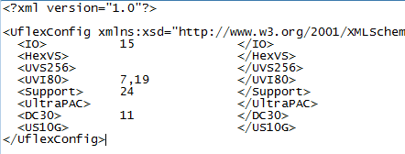
Pin Map and channel Map
Format for Tester config
Tester config is used to define the slot of instrument
To generate Pin Group
Base on the instrument type in tester config tool will generate All_[instrument type]. (ex. All_IO,All_UVI80)
To generate DCVI pin group (ex. DCVI for power pin group and DCVI_Analog for Analog pin group)

Slide 5
Pin Map and channel Map
Same channel pins
Tool will modify the channel name (ex. S:IDAC_OUT_0_DC30) when the channel are the same.
Rule for PMIC only
If the channel type is “DCVI”, tool will generate the secondary pin for DCDiffMeter & DCTime with the same channel as below.

Slide 6
Error Report
Checked by
Duplicated Pin name.
If channel/slot had be defined in testerconfig.
Site Count check for each pin.
Automatically Grouping Pins
For PMIC only, tool group pins when different pin had the same channel.
PaGroup sheet
To record the pin list that had be renamed.
(ex. BUCK6_LX_0 & BUCK6_LX_1 => BUCK6_LX)
MissingPaGroup sheet
To record the pin list that can’t be renamed.
(ex. ADC_IN_UVI80 & BRICK_ID1_UVI80 & BRICK_ID2_
UVI80 => no common pin name)

Slide 7
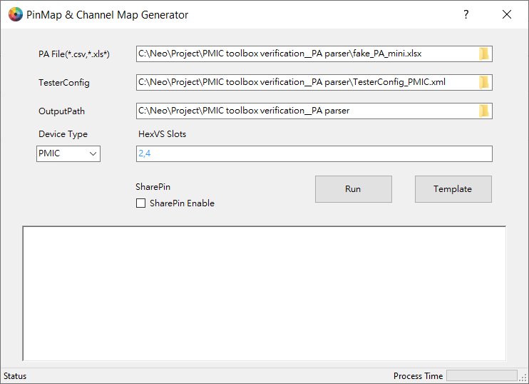
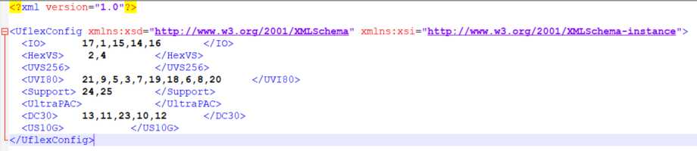
Pin Map and channel Map – HexVS Slots Info
The input box of HexVS Slots was shown the slot number of the HexVS instrument after you select TesterConfig.

Slide 8
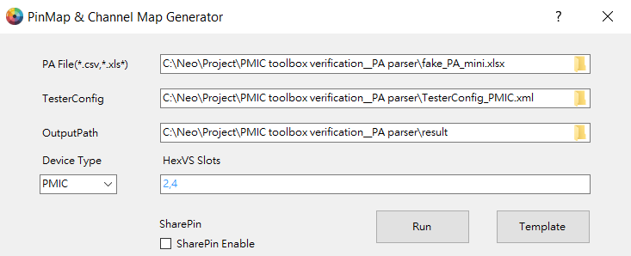
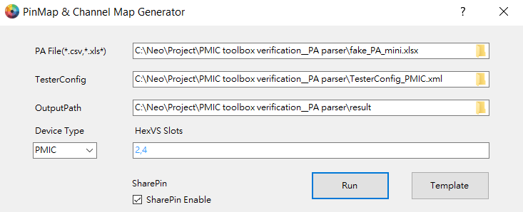
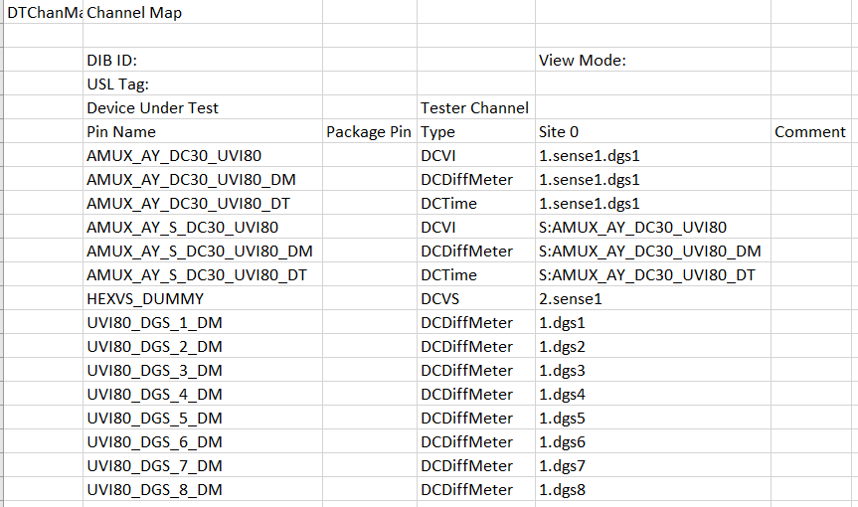
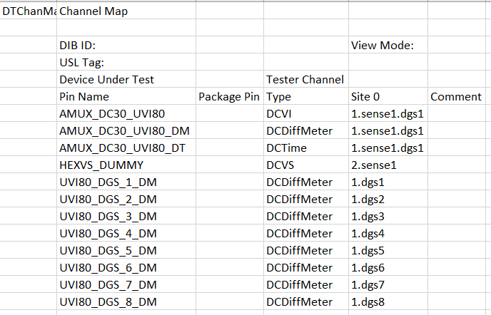
Pin Map and channel Map – SharePin Feature
Normal Case
Enable Share Pin Feature
PA file:
PA file:
Enter a Share pin name
Disable
Enable
Two pins in Chmap
Only share pin name in Chmap

